Slide 1
Ethics
What’s right?

Slide 2
What is ethics?
The principles that guide behavior
Moral philosophy about what is right and what is wrong
How you know what to do in a situation

Slide 3
Why discuss ethics?
You should know what you value
You should understand people differ
You cannot force your beliefs on others
You display your ethics every day by the behavior you model

Slide 4
How do you measure?

Slide 5
http://www.robertmartin.biz/ethics/ethics_examples.html

Slide 6
http://www.robertmartin.biz/ethics/ethics_examples.html

Slide 7
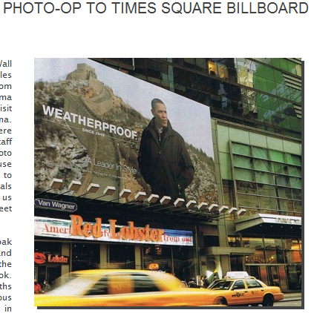
http://www.robertmartin.biz/ethics/ethics_examples.html

Slide 8
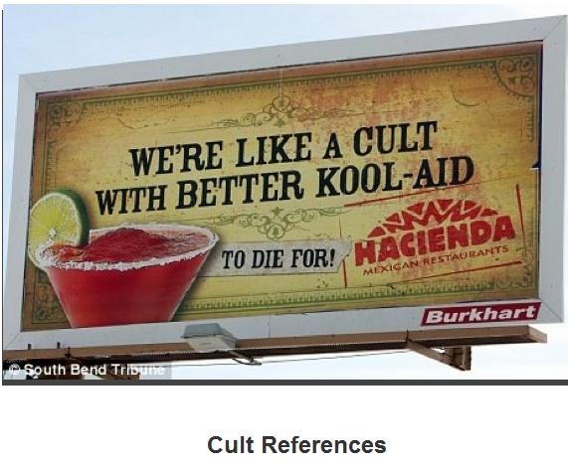
http://www.robertmartin.biz/ethics/ethics_examples.html

Slide 9
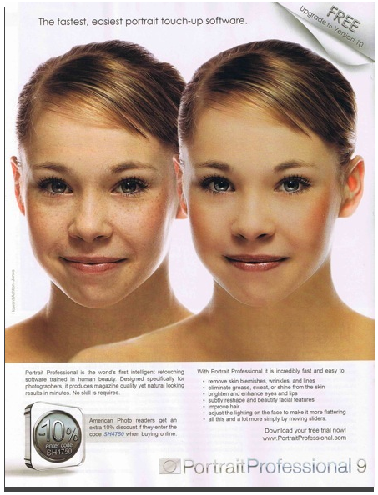
http://www.robertmartin.biz/ethics/ethics_examples.html

Slide 10
Workplace Ethics*
You are in the restroom and use the last piece of toilet paper. What do you do? -Leave with no concern -Address the issue
*http://humanresources.about.com/od/businessethics/qt/workplace-ethics.htm

Slide 11
Workplace Ethics*
It’s a beautiful work day, and you really want to get away, go to the beach, hike in the mountains, see your friend, or go shopping What do you do? -Call in sick (you have leave coming) -Go to work
*http://humanresources.about.com/od/businessethics/qt/workplace-ethics.htm

Slide 12
Workplace Ethics*
You are late getting back to work, and you have a dirty company cup What do you do? -Leave with no concern -Put it in the sink -Take it with you -Other
*http://humanresources.about.com/od/businessethics/qt/workplace-ethics.htm

Slide 13
Workplace Ethics*
You are working in a restaurant, and all staff share tips. You are just given a very large tip. What do you do?
*http://humanresources.about.com/od/businessethics/qt/workplace-ethics.htm

Slide 14
Workplace Ethics*
You are at work and all caught up. You need to do some online shopping. What do you do? -Shop -Find work to do
*http://humanresources.about.com/od/businessethics/qt/workplace-ethics.htm

Slide 15
Workplace Ethics*
You were just told some gossip about a coworker that you know is partially true. What do you do?
*http://humanresources.about.com/od/businessethics/qt/workplace-ethics.htm

Slide 16
Workplace Ethics
You forgot your lunch, and there has been a yogurt in the refrigerator for three days. It is not expired and appears abandoned. What do you do?

Slide 17
Workplace Ethics
You have the need to add two people to your team. Your good friend wants to join and work with you. What do you do?

Slide 18
You are a politician
…

Slide 19
Questions for you
To consider

Slide 20
Who monitors ethics?

Slide 21
Do ethics matter?

Slide 22
Do ethics matter?
To you?

Slide 23
Do your ethics matter?

Slide 24
Do your ethics matter?
To you?

Slide 25
Do your ethics matter?
To you? To the person next to you?

Slide 26
Why discuss ethics?

